Slide 1


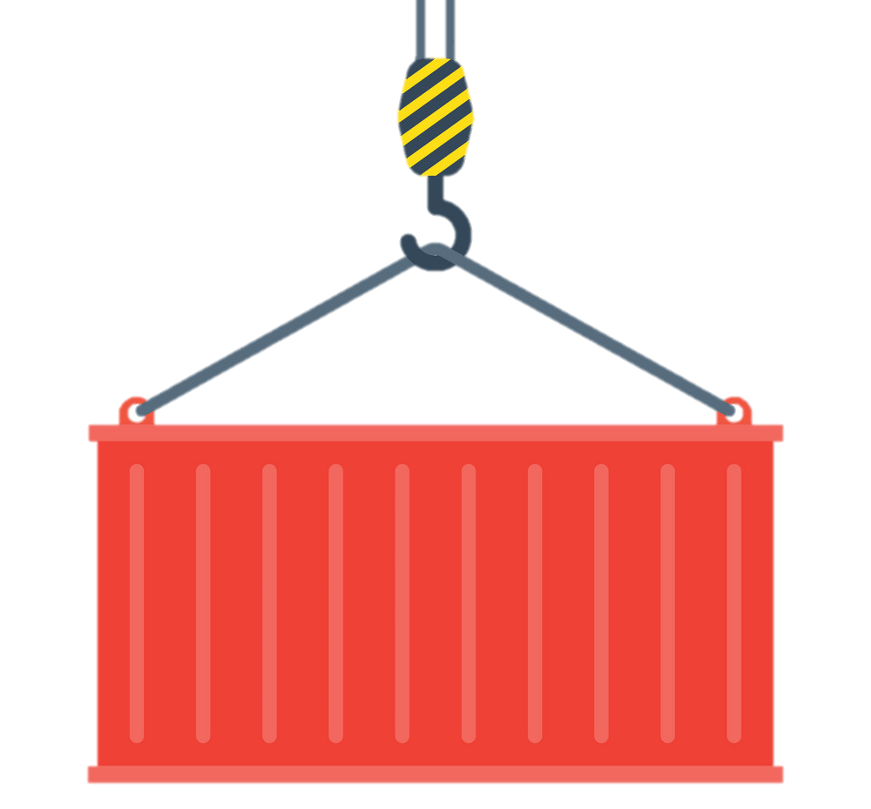
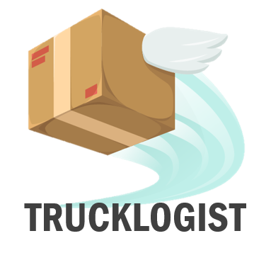
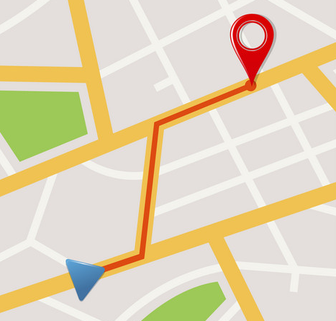
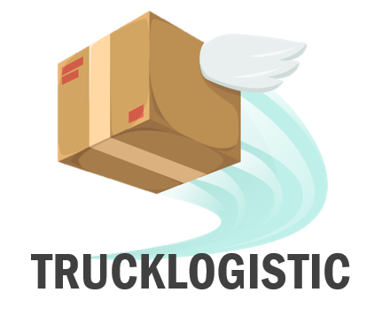

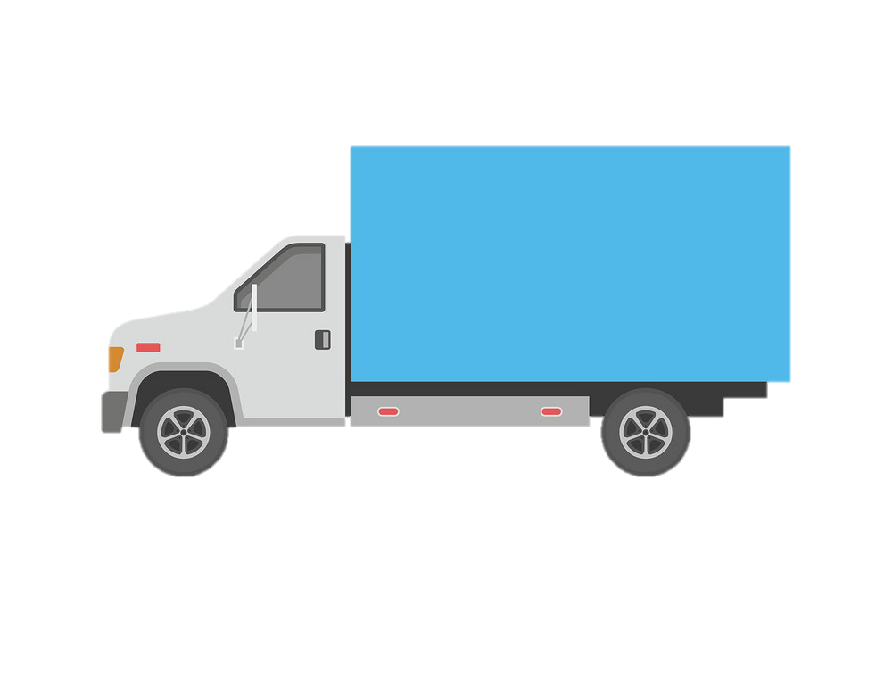
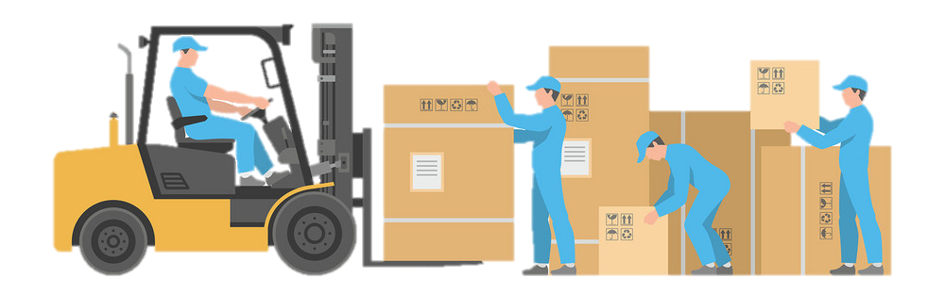
Logistic
DELIVERY
Credits

Slide 2

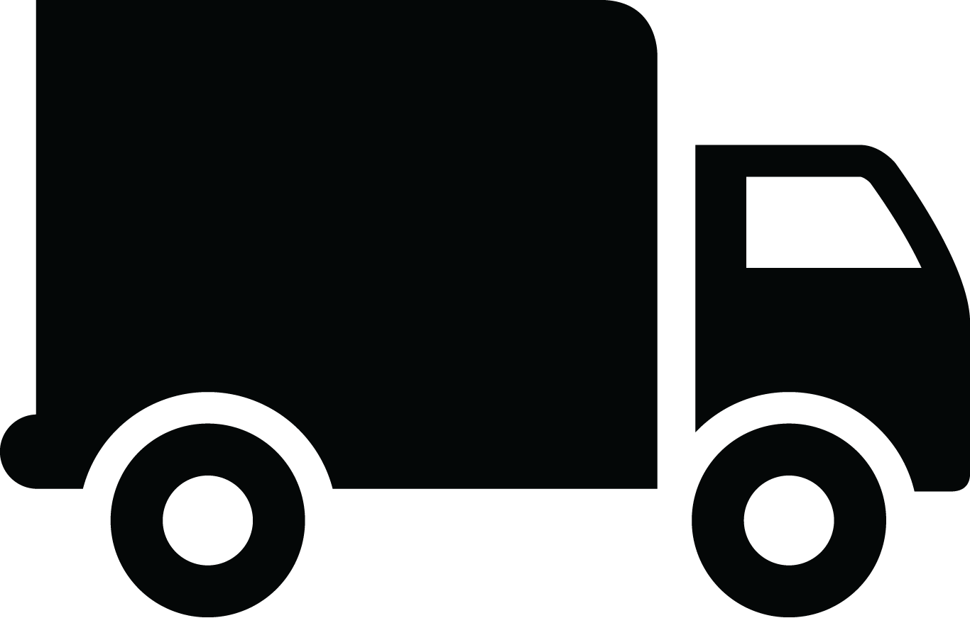
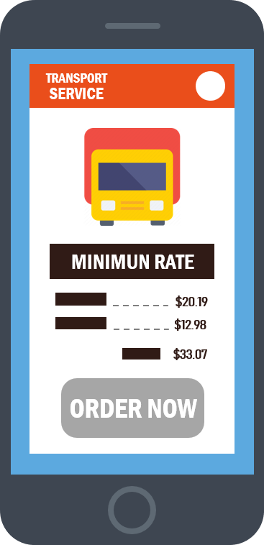





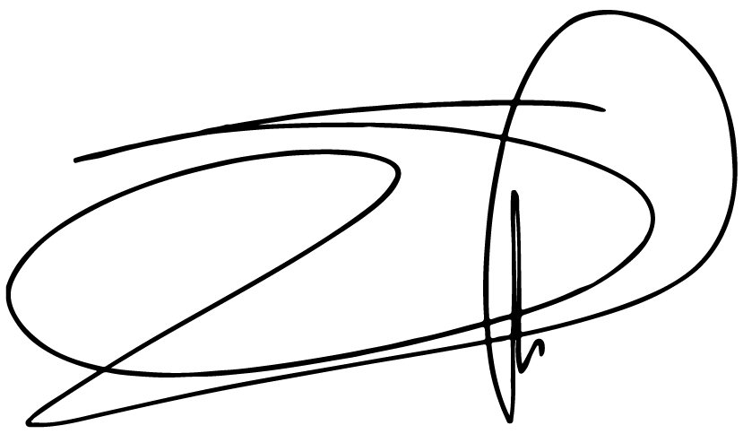
United States of America
N°:
3
Number of trucks
for the route
CEO: Marcos De Andrade
Samuel Boada
Welcome to the company Trucks Logistic, this company is responsible for making any shipment to all of Texas, so that we have more control of the transport of orders, it is necessary to detail some aspects of the shipments. Once chosen the desired amount give you check.
The maximum number of trucks for the transport of merchandise on the transportation routes allowed in the state of Texas according to the FMCSA is 200.
Number of routes:
Number of orders
for the truck
The maximum number of transportation routes allowed in the state of Texas according to the FMCSA is 200.
The maximum number of orders that each truck can carry in the state of Texas is 20.
Number of orders:
The maximum number of orders allowed in the state of Texas according to the law of the FMCSA is 3500.
General Manager. John Doe

Slide 3

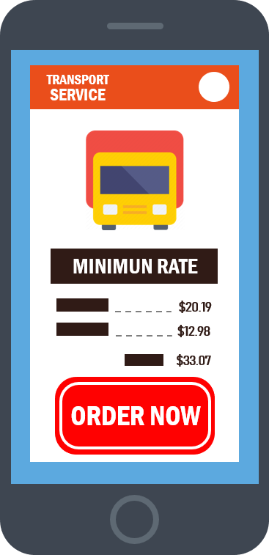
United States of America
N°:
3
6
Number of trucks
per routes:
CEO: Marcos De Andrade
Samuel Boada
Welcome to the company Trucks Logist, this company is responsible for making any shipment to all of Texas, so that we have more control of the transport of orders, it is necessary to detail some aspects of the shipments. Once chosen the desired amount give you check.
The maximum number of trucks for the transport of merchandise on the transportation routes allowed in the state of Texas according to the FMCSA is 200.
15
Number of orders
per truck:
Number of routes:
20
The maximum number of transportation routes allowed in the state of Texas according to the FMCSA is 200.
The maximum number of orders that each truck can carry in the state of Texas is 20.
20
Number of orders:
The maximum number of orders allowed in the state of Texas according to the law of the FMCSA is 3500.
General Manager. John Doe

Slide 4

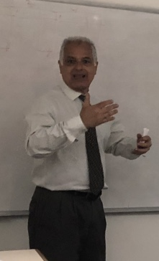

Slide 5


"TruckLogistic" is a logistics simulator of transport routes for trucks, Marcos De Andrade and Samuel Boada as a project of the subject Operational Systems of the Metropolitan University of Caracas, Venezuela, dictated by Lic. Luis Garcia as a teacher and by Jose Roberto Quevedo as a helper.
The purpose of this project is to make the student apply the Banker Algorithm and Interlock knowledges to comply with the orders in the most efficient way and in the shortest possible time.
Logistic
Credits
© 2019 – Marcos De Andrade, Samuel Boada. All rights reserved

Slide 6
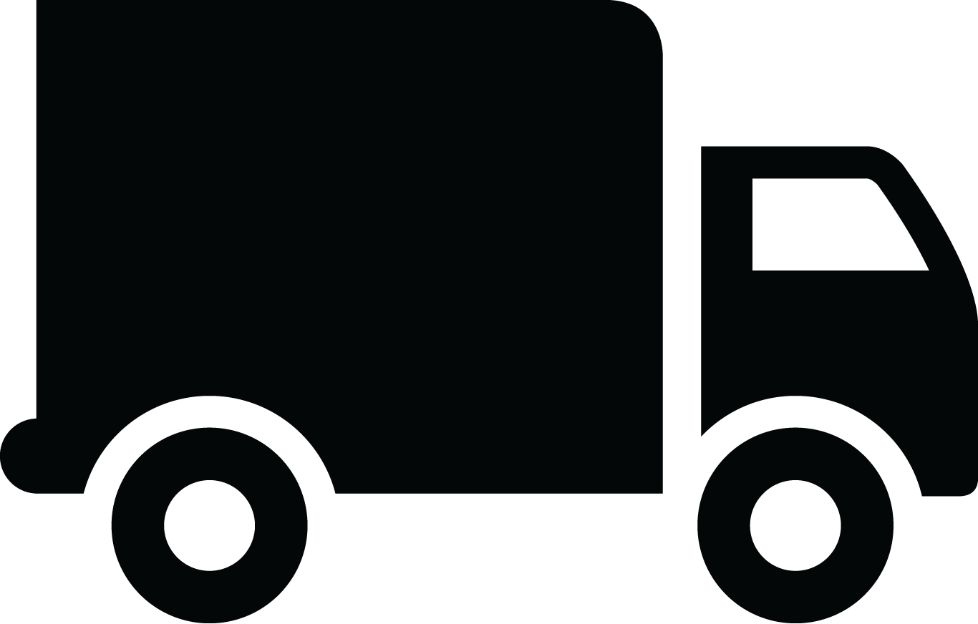
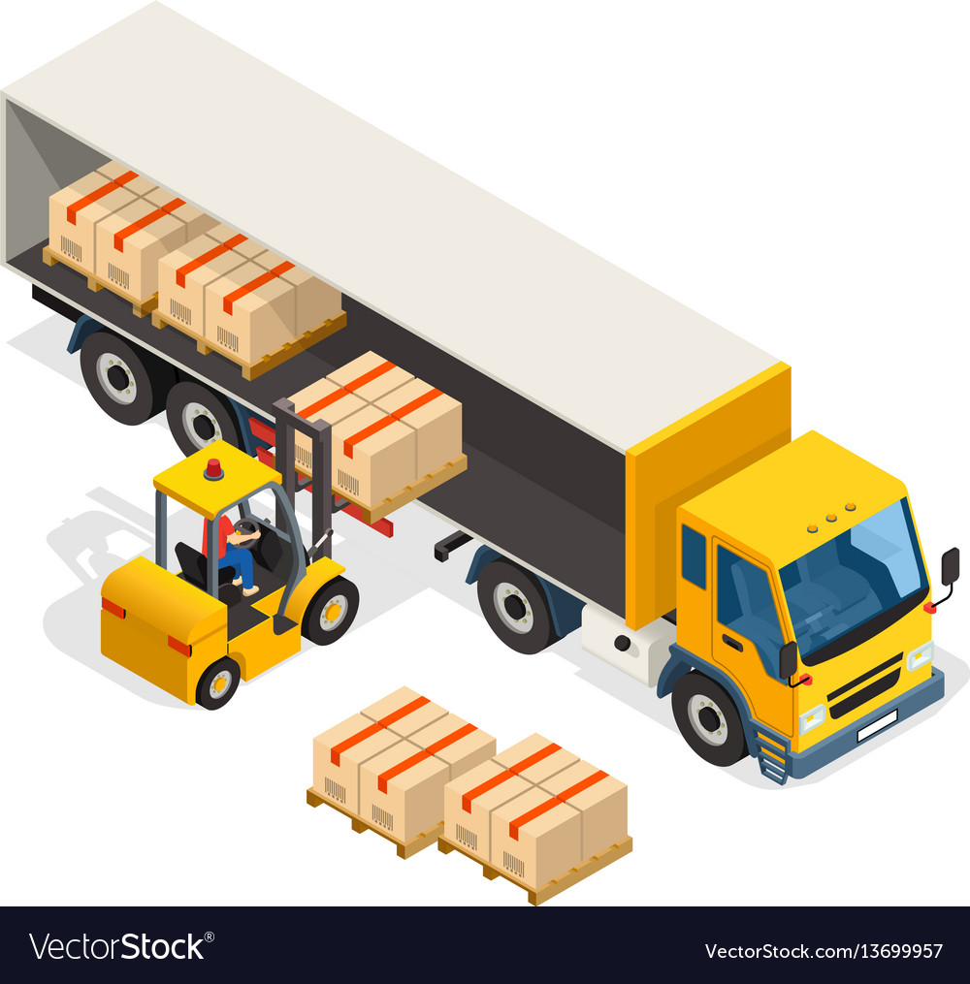
!
Are you sure you want to cancel the order?
"TruckLogistic" is a logistics simulator of transport routes for trucks, Marcos De Andrade and Samuel Boada as a project of the subject Operational Systems of the Metropolitan University of Caracas, Venezuela, dictated by Lic. Luis Garcia as a teacher and by Jose Roberto Quevedo as a helper.
The purpose of this project is to make the student apply the Banker Algorithm and Interlock knowledges to comply with the orders in the most efficient way and in the shortest possible time.
Yes
No
© 2019 - Marcos De Andrade, Samuel Boada. All rights reserved
!
Insert the data correctly?
Acept

Slide 9
DELIVERY

Slide 10
United States of America
N°:
Number of trucks
for the route
CEO: Marcos De Andrade
Samuel Boada
Welcome to the company Trucks Logistic, this company is responsible for making any shipment to all of Texas, so that we have more control of the transport of orders, it is necessary to detail some aspects of the shipments. Once chosen the desired amount give you check.
The maximum number of trucks for the transport of merchandise on the transportation routes allowed in the state of Texas according to the FMCSA is 200.
Number of routes:
Number of orders
per truck:
The maximum number of transportation routes allowed in the state of Texas according to the FMCSA is 200.
The maximum number of orders that each truck can carry in the state of Texas is 20.
Number of orders:
The maximum number of orders allowed in the state of Texas according to the law of the FMCSA is 3500.
General Manager. John Doe

Slide 11
United States of America
N°:
Number of trucks
for the route
CEO: Marcos De Andrade
Samuel Boada
Welcome to the company Trucks Logistic, this company is responsible for making any shipment to all of Texas, so that we have more control of the transport of orders, it is necessary to detail some aspects of the shipments. Once chosen the desired amount give you check.
The maximum number of trucks for the transport of merchandise on the transportation routes allowed in the state of Texas according to the FMCSA is 200.
Number of routes:
Number of orders
per truck:
The maximum number of transportation routes allowed in the state of Texas according to the FMCSA is 200.
The maximum number of orders that each truck can carry in the state of Texas is 20.
Number of orders:
The maximum number of orders allowed in the state of Texas according to the law of the FMCSA is 3500.
General Manager. John Doe

Slide 12
United States of America
N°:
Trucks
For the route
CEO: Marcos De Andrade
Samuel Boada
Welcome to the company Trucks Logistic, this company is responsible for making any shipment to all of Texas, so that we have more control of the transport of orders, it is necessary to detail some aspects of the shipments. Once chosen the desired amount give you check.
The maximum number of trucks for the transport of merchandise on the transportation routes allowed in the state of Texas according to the FMCSA is 200.
Number of routes:
Number of trucks
for the route
In this order
The maximum number of transportation routes allowed in the state of Texas according to the FMCSA is 200.
Number of orders:
The maximum number of orders allowed in the state of Texas according to the law of the FMCSA is 3500.
General Manager. John Doe

Slide 14


Slide 16
"TruckLogistic" is a logistics simulator of transport routes for trucks, Marcos De Andrade and Samuel Boada as a project of the subject Operational Systems of the Metropolitan University of Caracas, Venezuela, dictated by Lic. Luis Garcia as a teacher and by Jose Roberto Quevedo as a helper.
The purpose of this project is to make the student apply the Banker Algorithm and Interlock knowledges to comply with the orders in the most efficient way and in the shortest possible time.
© 2019 – Marcos De Andrade, Samuel Boada. All rights reserved

Slide 17
!
Are you sure you want to cancel the order?
"TruckLogistic" is a logistics simulator of transport routes for trucks, Marcos De Andrade and Samuel Boada as a project of the subject Operational Systems of the Metropolitan University of Caracas, Venezuela, dictated by Lic. Luis Garcia as a teacher and by Jose Roberto Quevedo as a helper.
The purpose of this project is to make the student apply the Banker Algorithm and Interlock knowledges to comply with the orders in the most efficient way and in the shortest possible time.
© 2019 - Marcos De Andrade, Samuel Boada. All rights reserved
!
Insert the data correctly?

